Slide 1
8th Wonder Cinema
Ealija Abbas

Slide 2
Preamble:
A group of entrepreneurs are creating a business plan for a new streaming platform that focuses on only the best movies. They are starting from scratch and would like to know which factors directly contribute to the success of a movie. They hired me to find out.

Slide 3
Problem Statement:
So what makes a good movie and how can I find that out?
Variables include:
Genre
Budget
Director
Release month
Studio
Runtime
Country
Measures of success:
IMDB score
Gross profit

Slide 4
Benefits:
The Business model for the 8th Wonder Cinema will be structured based on my analytical findings.

Slide 5
Methodology:
For my visualizations I wanted to clearly show how the variables that the studio has direct control of contribute to the success or failure of the movie.
So I split up independent variables and the dependent variables (measures of success)
Used Plotly for Visualizations

Slide 6
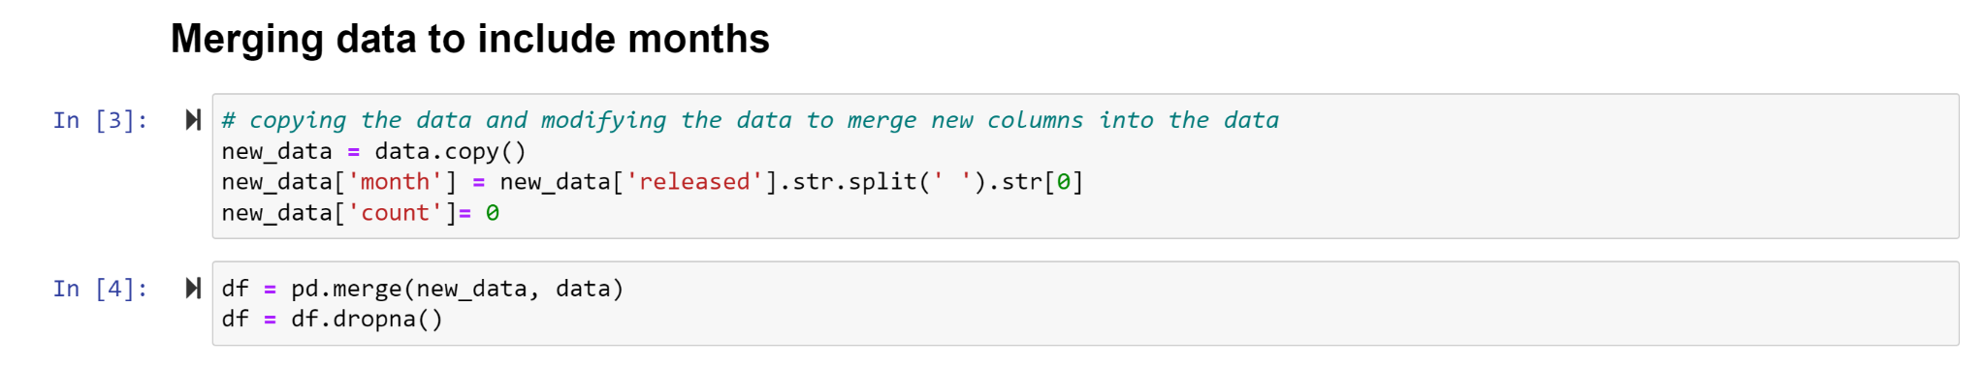
Methodology Pt 2: Challenges
Initially when I read in the data, the release date column had the full numerical dates including month/day/year.
To tailor the data set to they way I wanted to show it I did a merge to cut out everything but the month

Slide 7
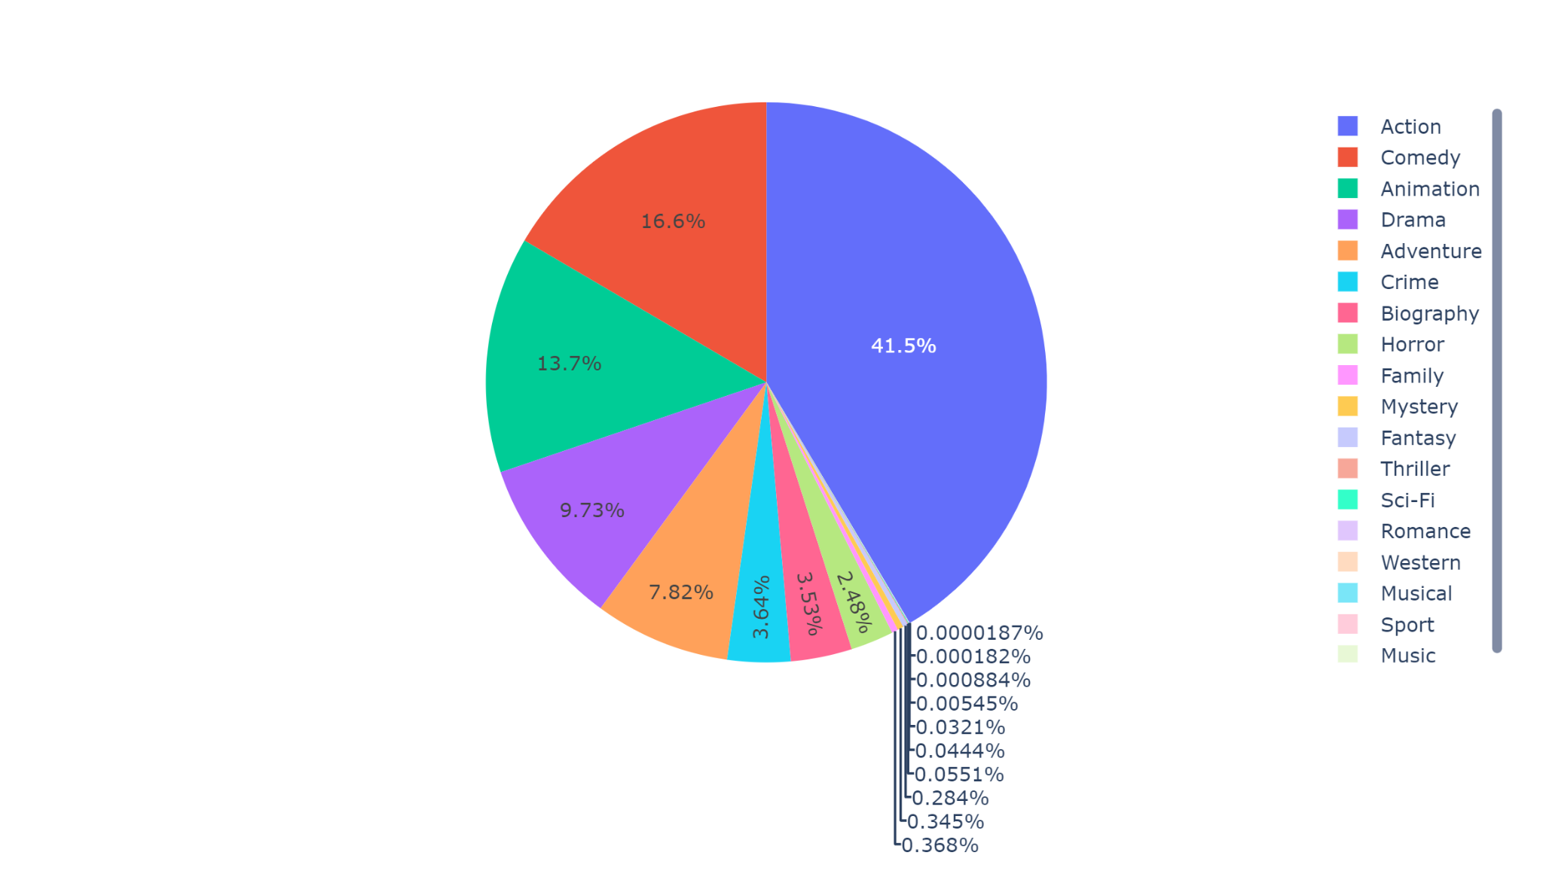
Pie Chart: Which genre takes up most of the gross profit

Slide 8
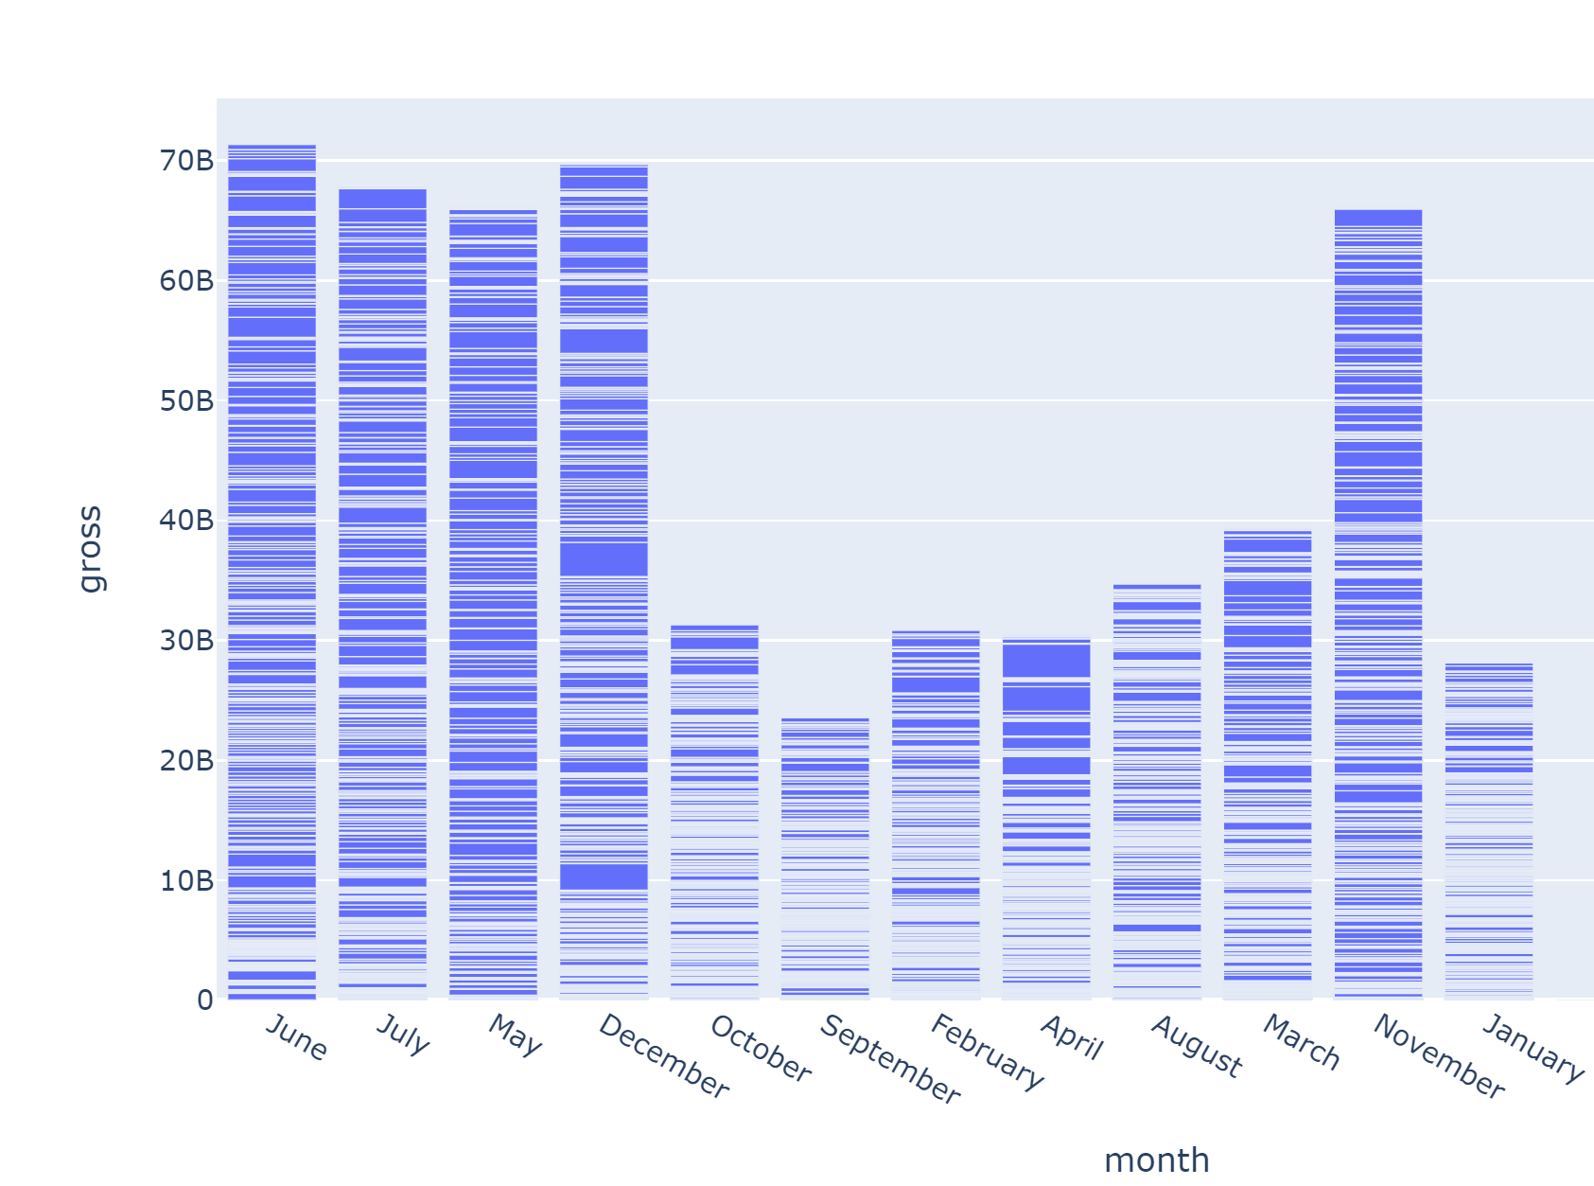
Bar Chart: Does Release Date Matter?

Slide 9
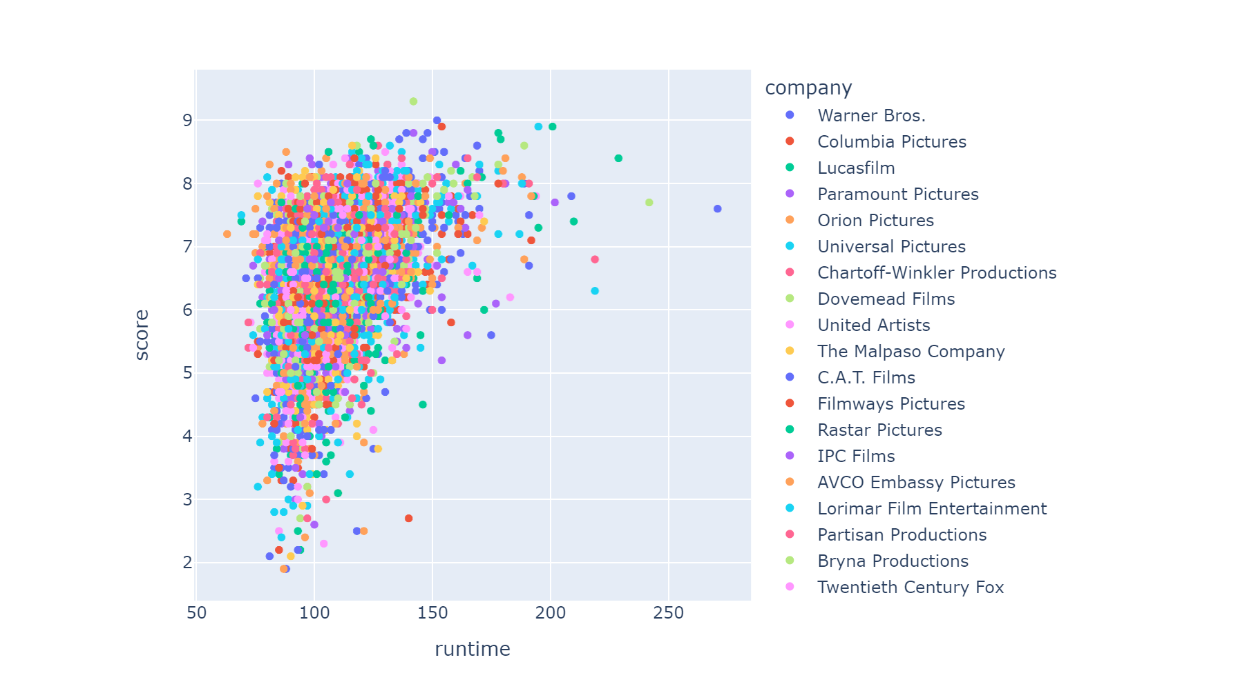
Scatter Plot: Longer Movies are boring??

Slide 10
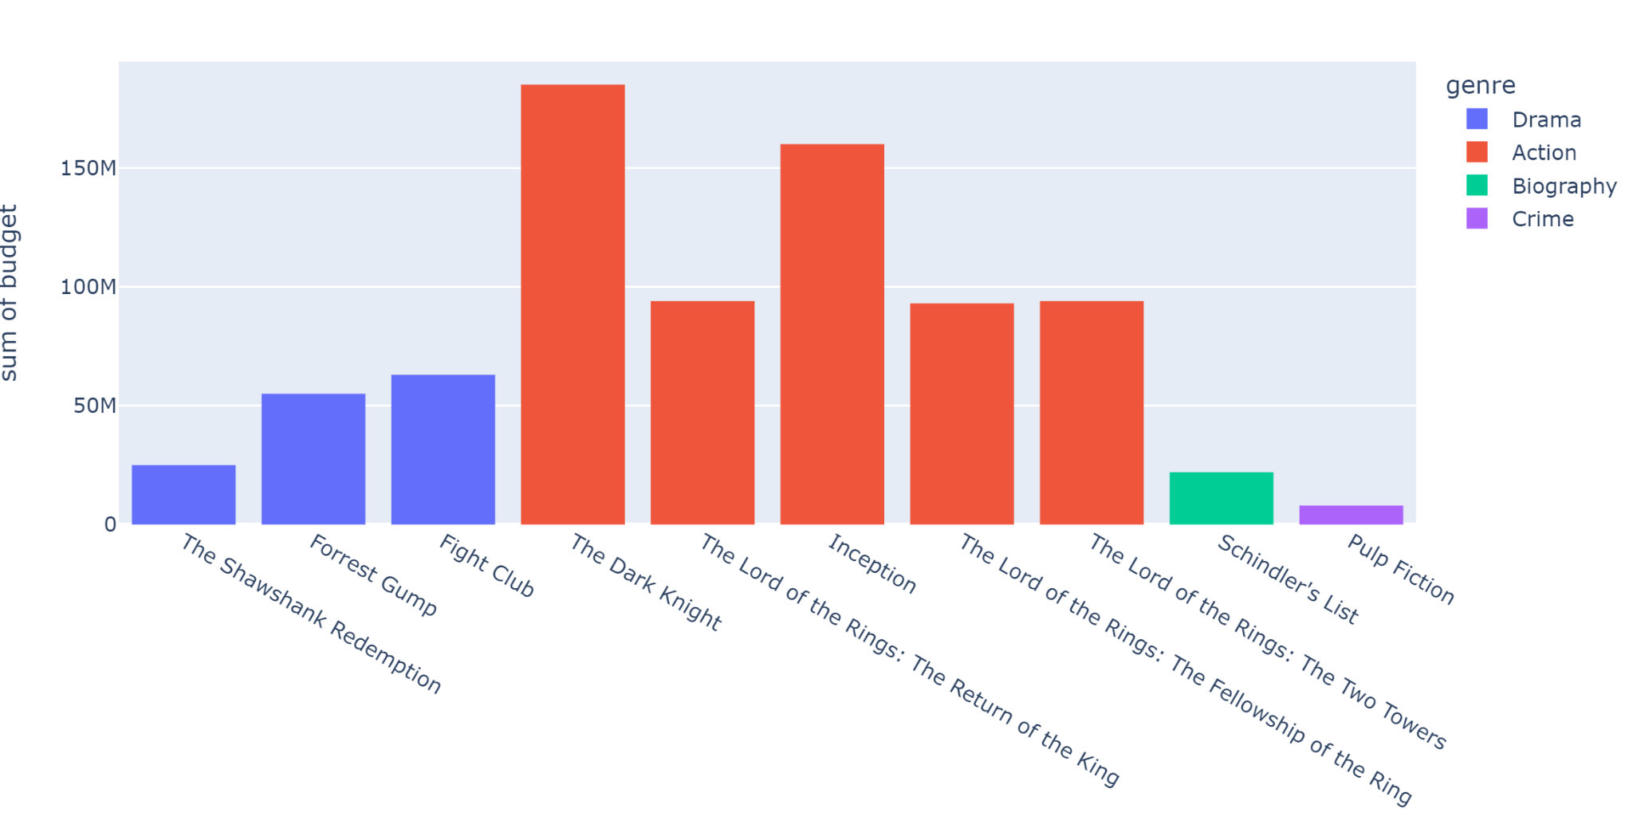
Histogram: Top 10 movies and their budgets

Slide 11
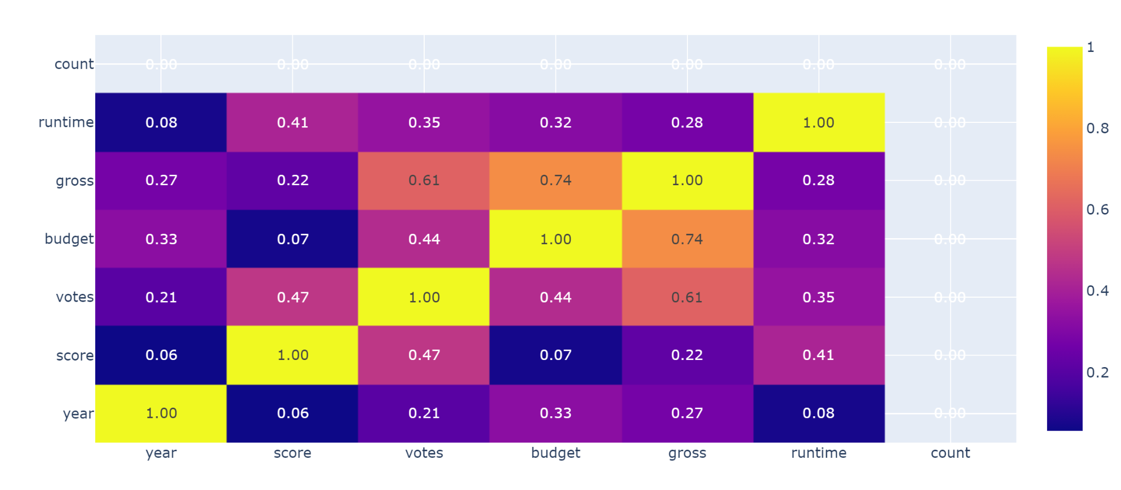
Correlation Heatmap: How do these variables fit each other?

Slide 12
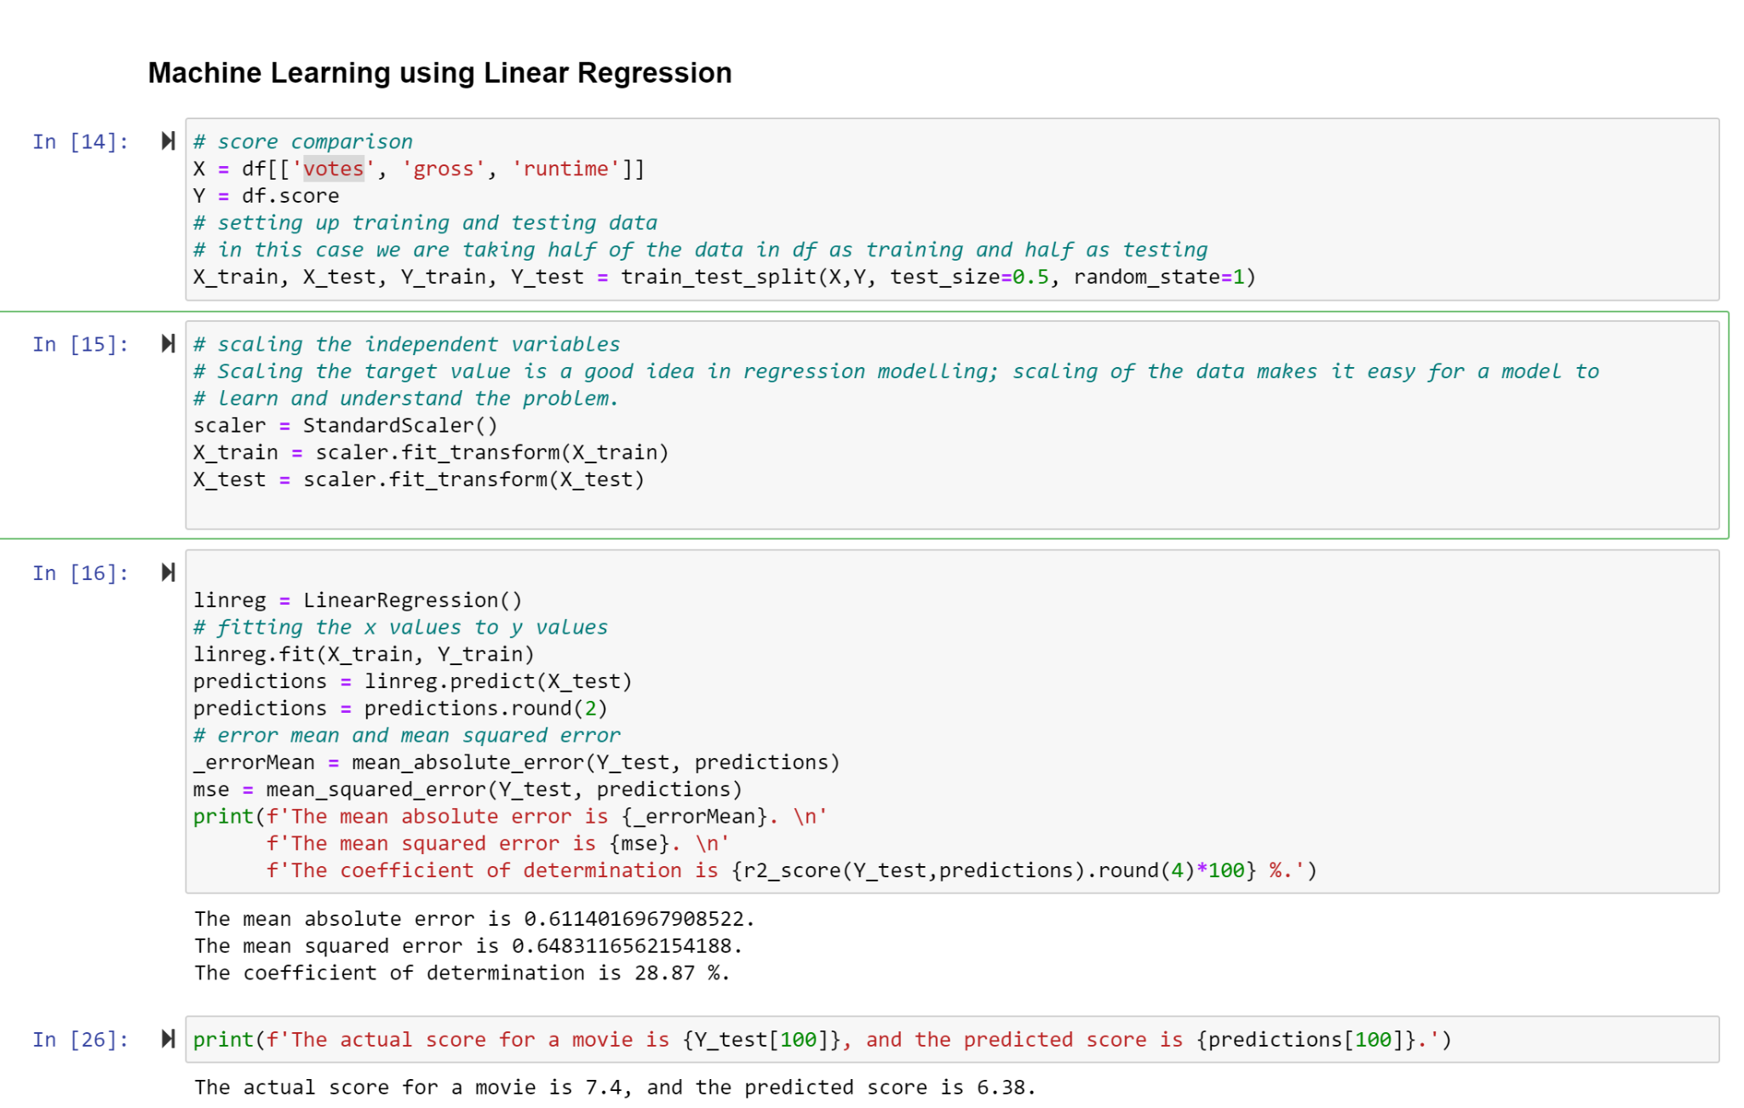
Machine Learning: Linear Regression

Slide 13
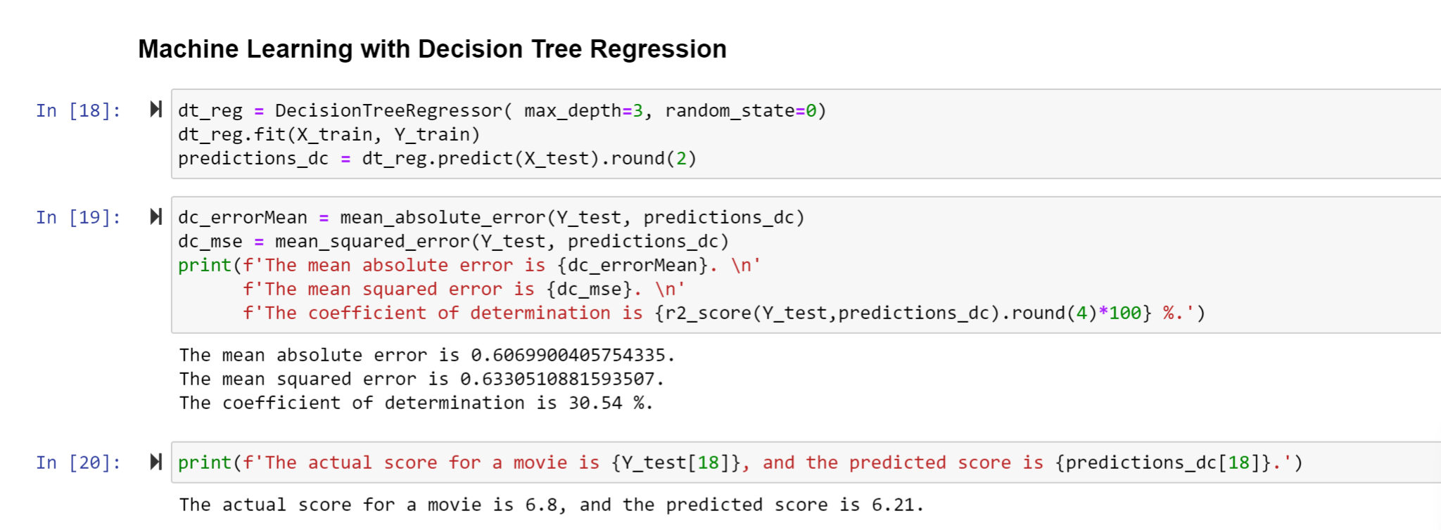
Machine Learning: Decision Tree

Slide 14
Insights/Recommendation:
I learned that a successful movie on paper should be:
An action film.
Released in summer months or leading up to Christmas time.
Had a runtime over 150 mins
A higher budget does get movies into a top 10 rating

Slide 15
What I could have done better….
My Machine Learning needs some work, training director with IMDB rating could have produced better results.

